Slide 1
Neural Network I
Chul Min Yeum
Assistant Professor
Civil and Environmental Engineering
University of Waterloo, Canada
CIVE 497 – CIVE 700: Smart Structure Technology
Last updated: 2020-03-27

Slide 2
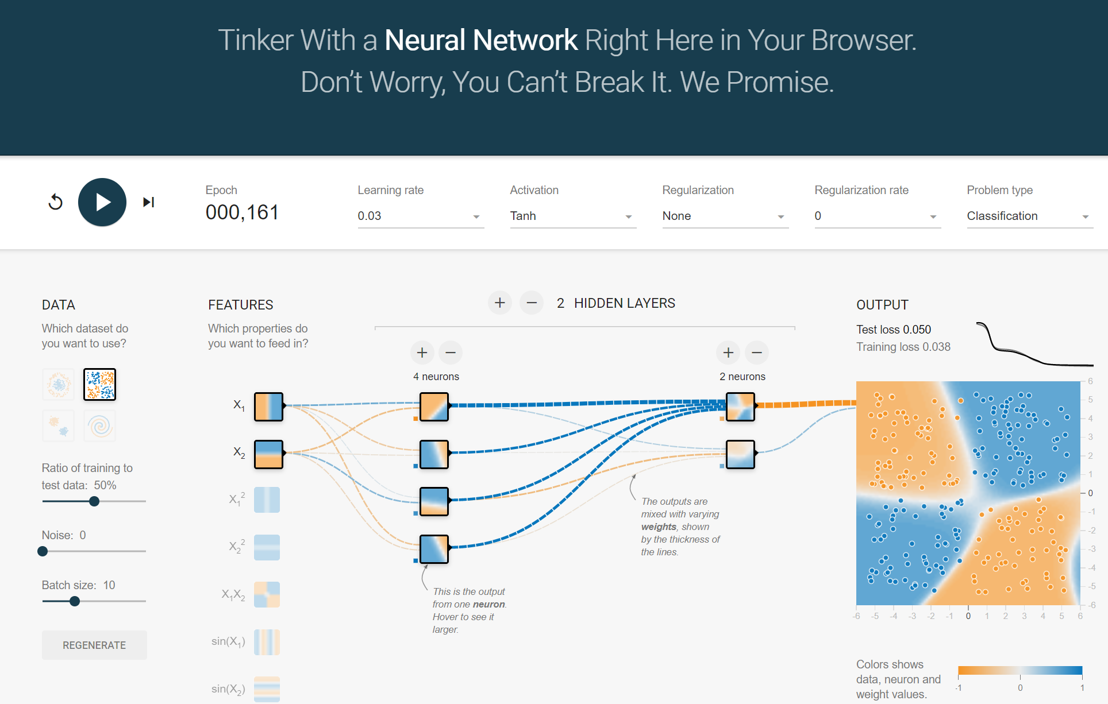
Neural Network Playground
http://playground.tensorflow.org/

Slide 3
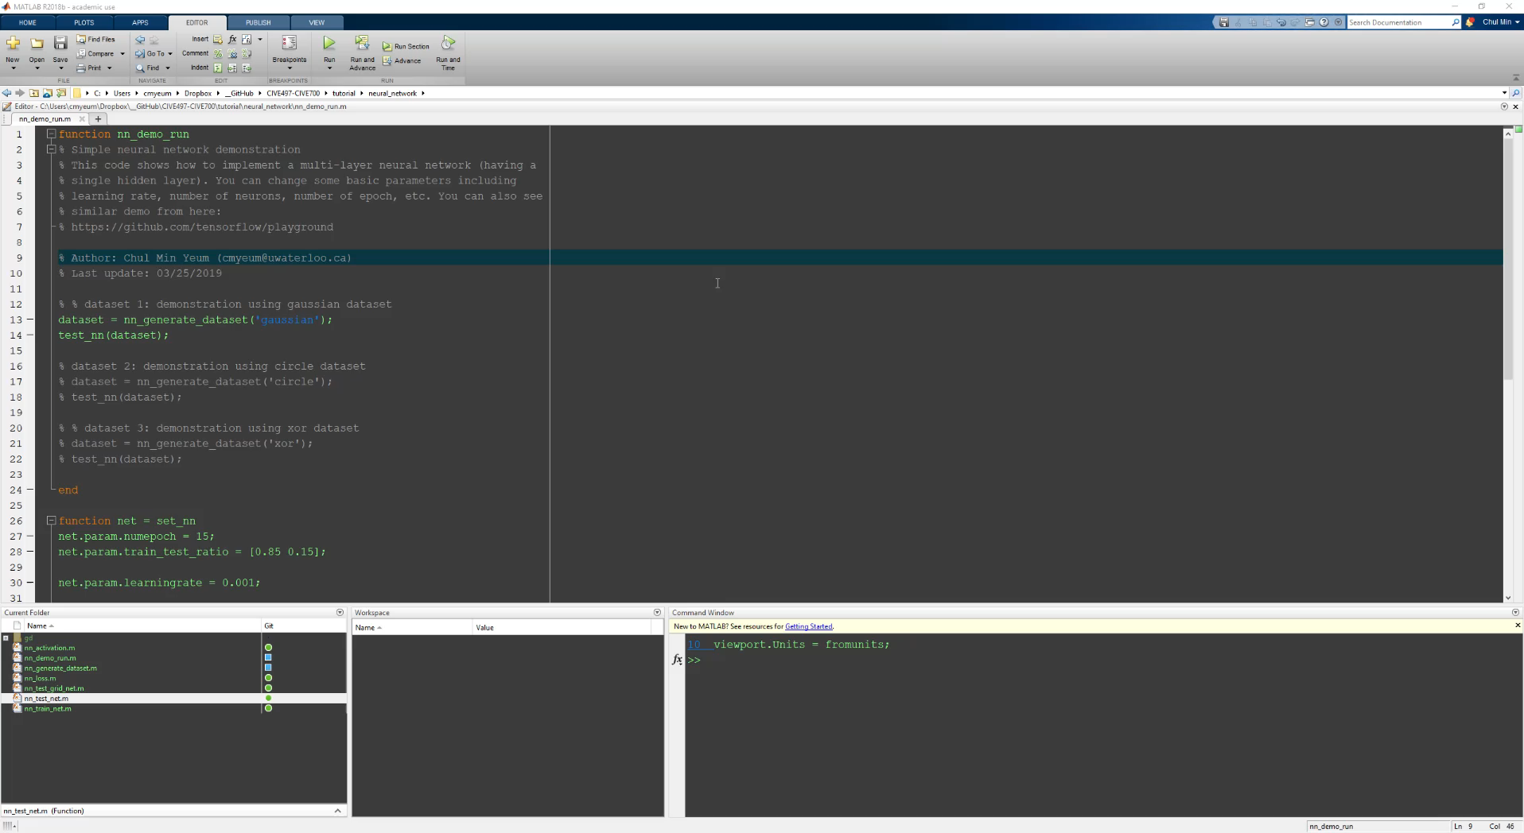
Tutorial: Binary Classification (Gaussian)

Slide 4
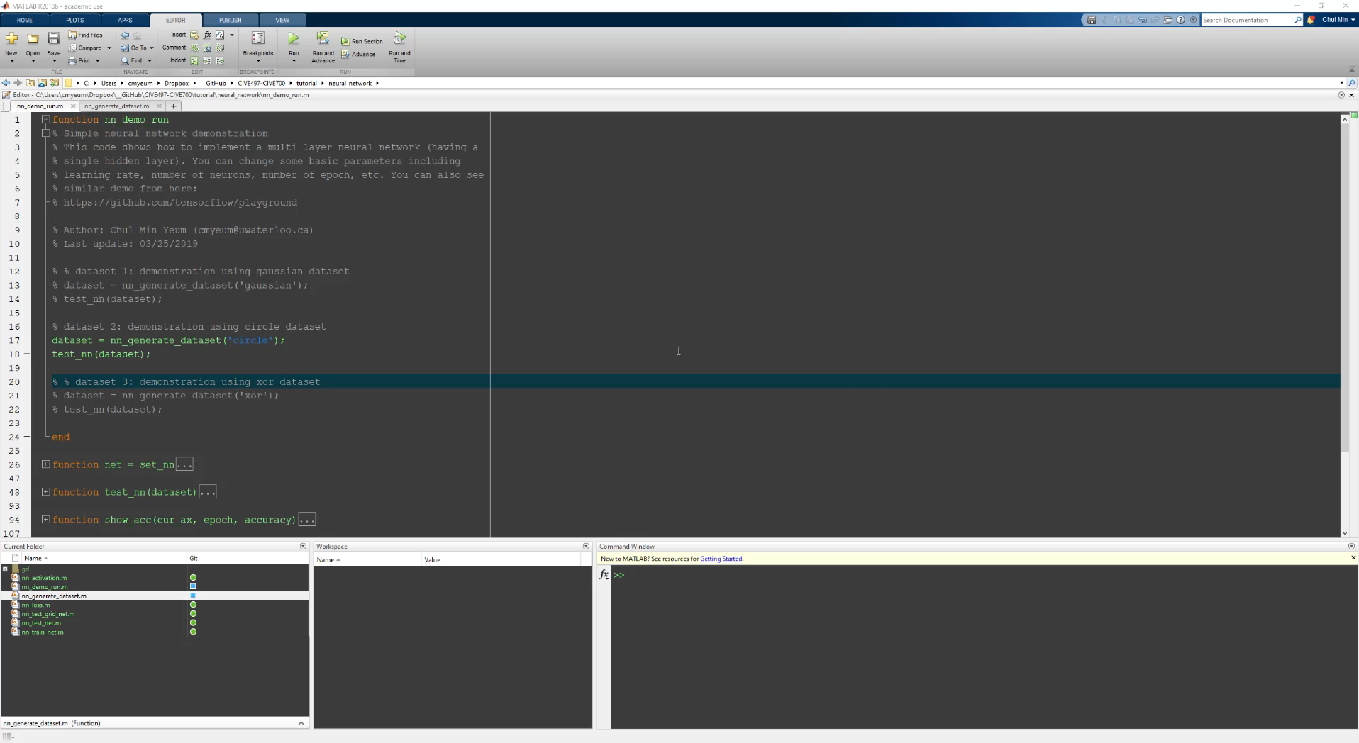
Tutorial: Binary Classification (Circle)

Slide 5
Supervised Neural Networks
Inputs
Learn (Input, Output)
updates internal state
Outputs
updates internal state
Predict from (inputs)
Inputs
Outputs

Slide 6
Gradient Descent
Both of us (Terence and Jeremy) have a story where we had to make our way down a mountain in the pitch black of night or dense fog. (Spoiler alert: we both made it back!) Obviously, the way to get down is to keep going downhill until you reach the bottom, taking steps to the left, right, forward, backward or at an angle in order to minimize the “elevation function.” Rather than trying to find the best angle to step, we can treat each direction, forward/backward and left/right, separately and then combine them to obtain the best step direction. The procedure is to swing your foot forwards and backwards to figure out which way is downhill on, say, the North/South axis, then swing your foot left and right to figure out which way is downhill on the East/West axis (Boot clipart from http://etc.usf.edu/clipart/):
IMAGE!!!
The idea is to take big steps along an axis when the slope is steep but small steps when the slope is shallow.
https://explained.ai/gradient-boosting/descent.html

Slide 7
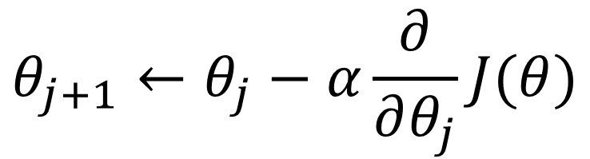
Gradient Descent (Continue)
Gradient descent is an iterative machine learning optimization algorithm to reduce the cost function so that we have models that makes accurate predictions.
Cost function(J) or loss function measures the difference between the actual output and predicted output from the model.
$$θ_{j+1}←θ_{j}−α\frac{∂}{∂θ_{j}}J(θ)$$
Repeat until convergence

Slide 8
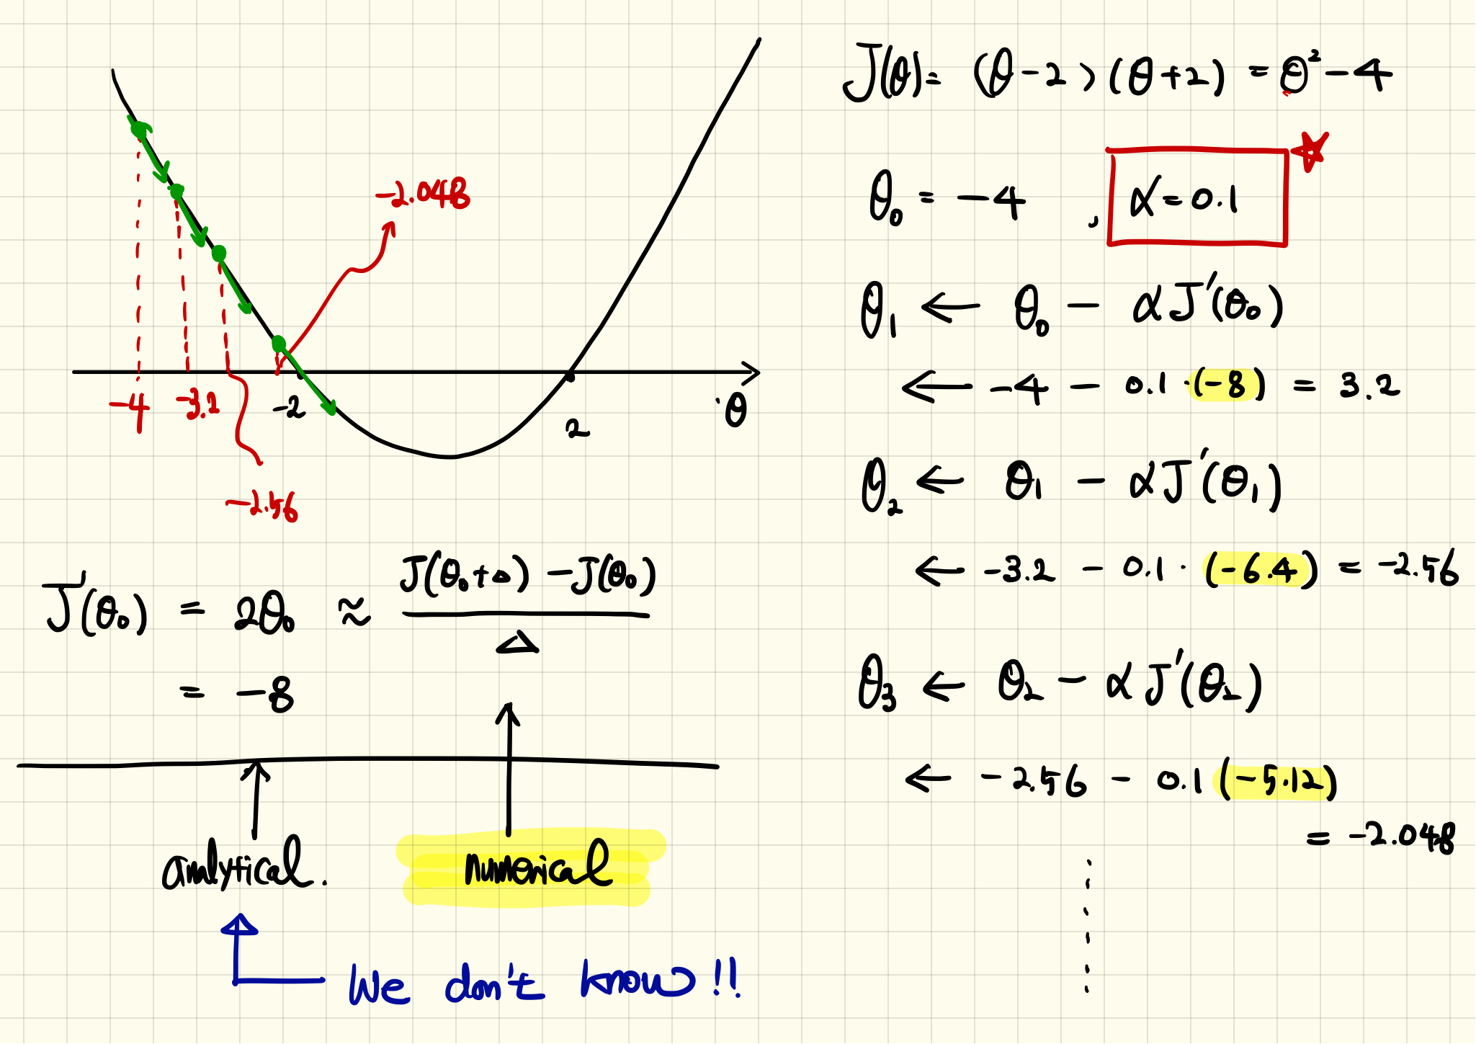
Example: Quadratic Function

Slide 9
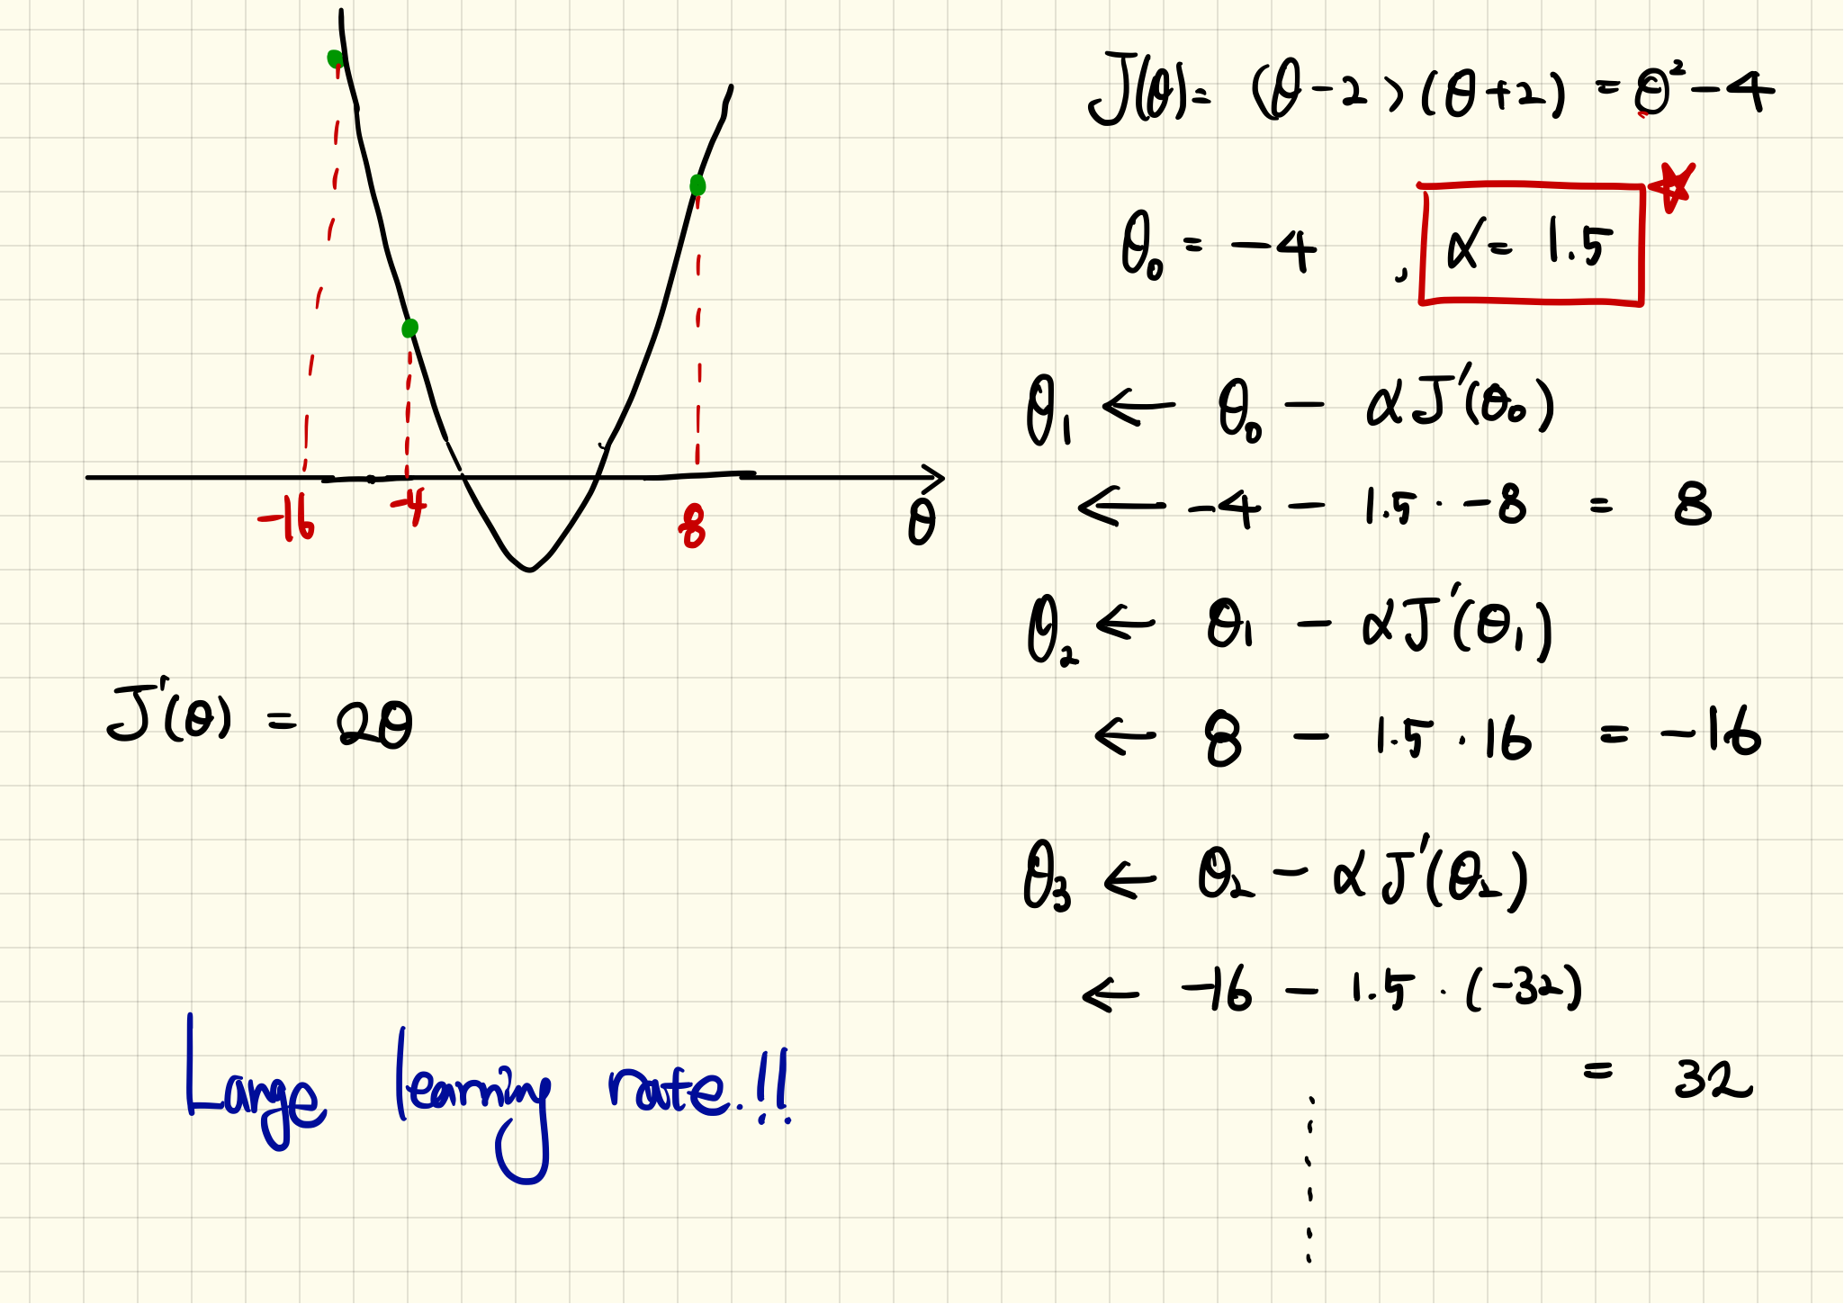
Example: Quadratic Function (Continue)

Slide 10
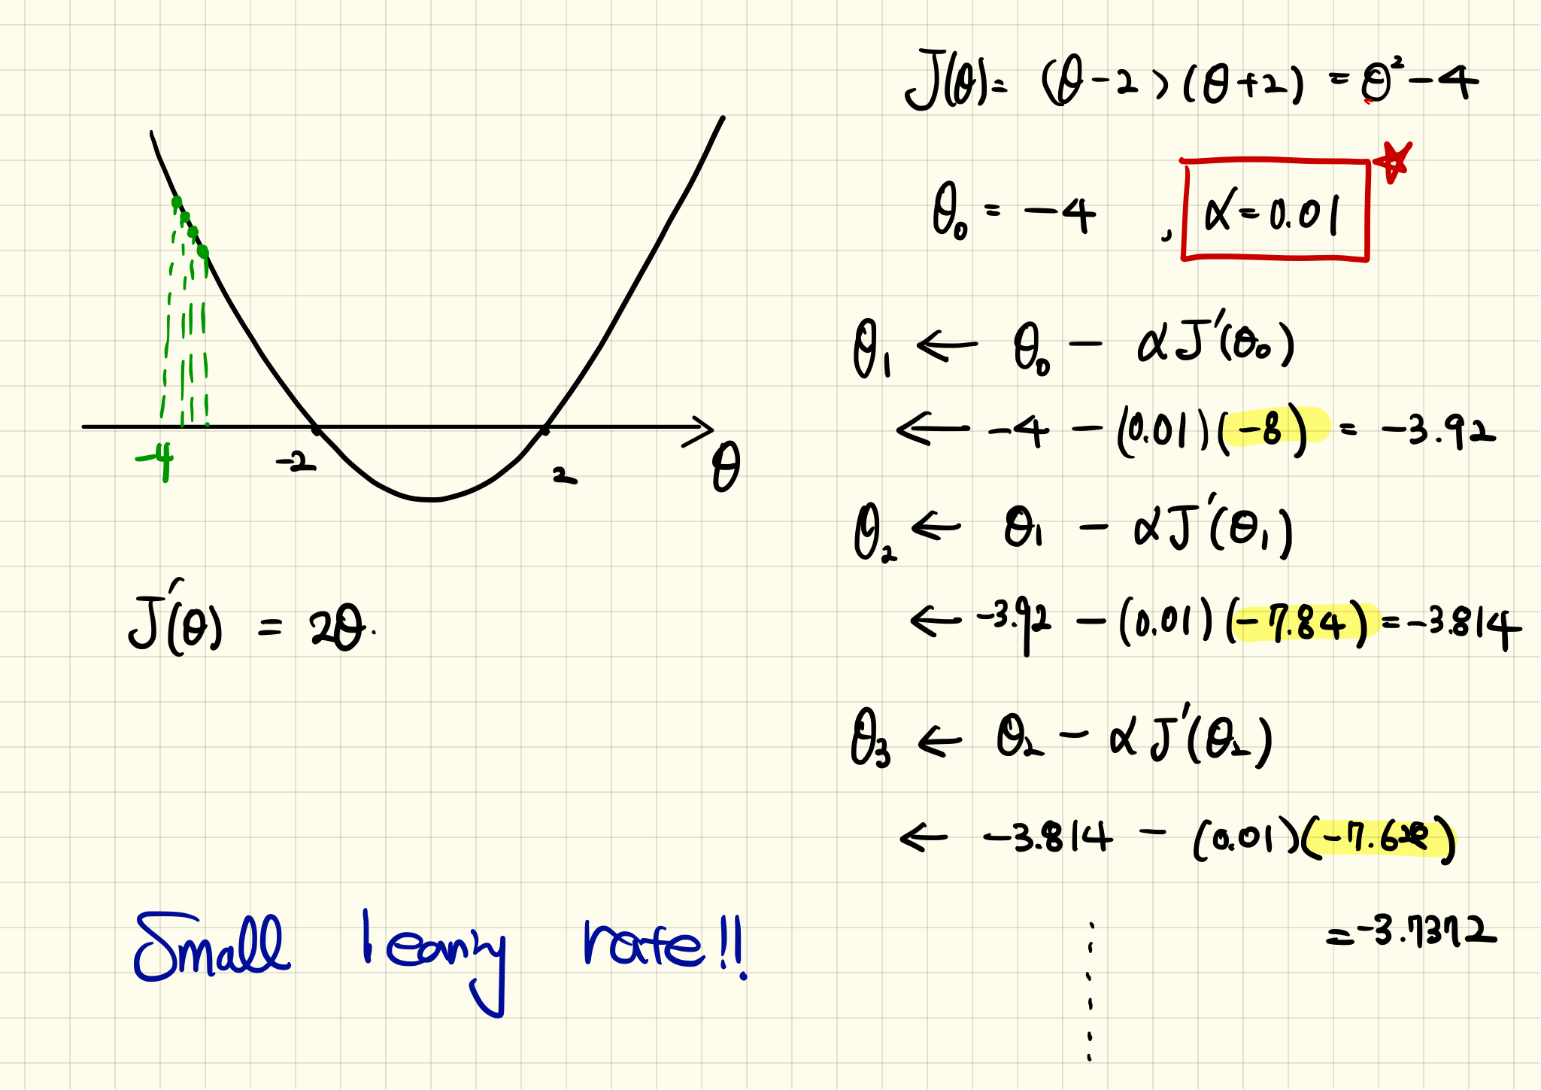
Example: Quadratic Function (Continue)

Slide 11
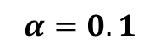
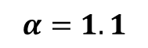
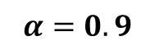
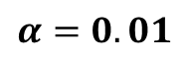
Example: Quadratic Function (Simulation)
10 iterations
$$α=0.1$$
$$α=0.01$$
$$α=1.1$$
$$α=0.9$$
See tutorials

Slide 12

Effect of Learning Rates

Slide 13
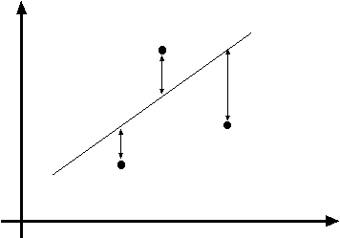
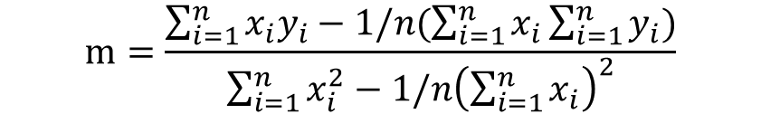
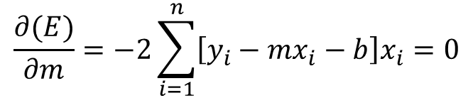
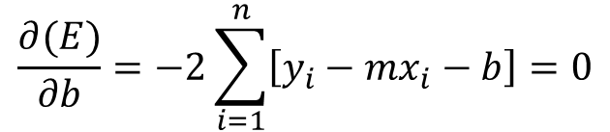
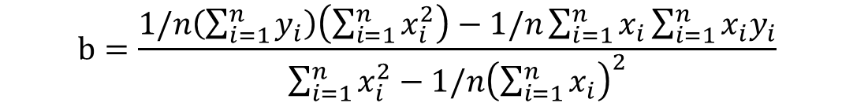
Recall: Least Squares Line Fitting
Data (measurement): (x₁, y₁), …, (x_{n}, y_{n})
Model: Line (y_{i} = m x_{i} + b)
Task: Find (m, b)
y=mx+b
(x_{i}, y_{i})
Minimize
$$m=\frac{\sum_{i=1}^{n}{x_{i}y_{i}−1/n(\sum_{i=1}^{n}{x_{i}}\sum_{i=1}^{n}{y_{i}})}}{\sum_{i=1}^{n}{x_{i}^{2}}−{1/n\left(\sum_{i=1}^{n}{x_{i}}\right)}^{2}}$$
$$\frac{∂(E)}{∂m}=−2\sum_{i=1}^{n}{\left[y_{i}−mx_{i}−b\right]x_{i}}=0$$
$$b=\frac{1/n\left(\sum_{i=1}^{n}{y_{i}}\right)\left(\sum_{i=1}^{n}{x_{i}^{2}}\right)−1/n\sum_{i=1}^{n}{x_{i}}\sum_{i=1}^{n}{x_{i}y_{i}}}{\sum_{i=1}^{n}{x_{i}^{2}}−{1/n\left(\sum_{i=1}^{n}{x_{i}}\right)}^{2}}$$
$$\frac{∂(E)}{∂b}=−2\sum_{i=1}^{n}{\left[y_{i}−mx_{i}−b\right]}=0$$

Slide 14
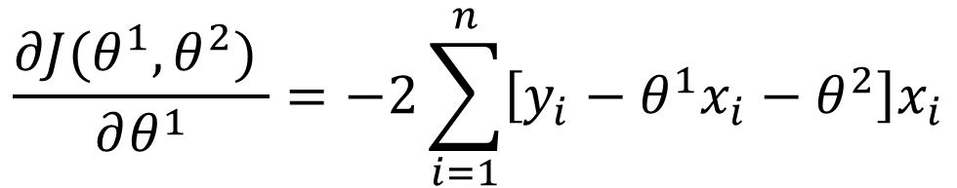
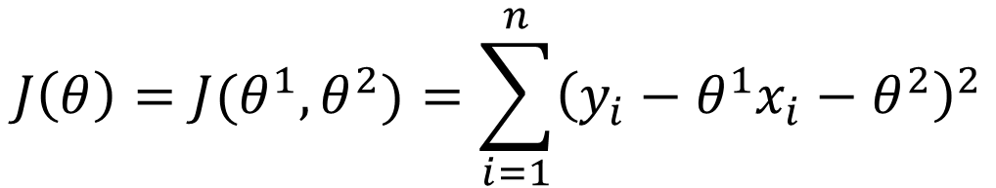
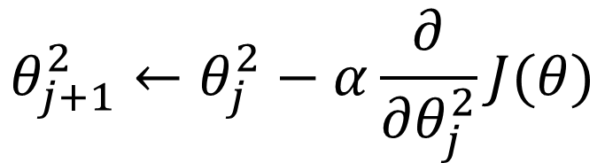
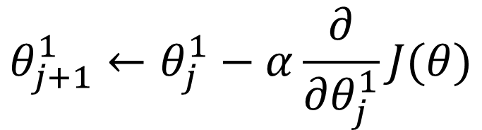
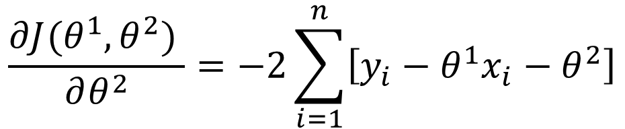
Line Fitting using Gradient Descent
Cost function:
$$J\left(θ\right)=J(θ^{1},θ^{2})=\sum_{i=1}^{n}{{\left(y_{i}−θ^{1}x_{i}−θ^{2}\right)}^{2}}$$
Derivatives:
Updated rules:
$$\frac{∂J(θ^{1},θ^{2}) }{∂θ^{1}}=−2\sum_{i=1}^{n}{\left[y_{i}−θ^{1}x_{i}−θ^{2}\right]x_{i}}$$
$$θ_{j+1}^{1}←θ_{j}^{1}−α\frac{∂}{∂θ_{j}^{1}}J(θ)$$
$$\frac{∂J(θ^{1},θ^{2}) }{∂θ^{2}}=−2\sum_{i=1}^{n}{\left[y_{i}−θ^{1}x_{i}−θ^{2}\right]}$$
$$θ_{j+1}^{2}←θ_{j}^{2}−α\frac{∂}{∂θ_{j}^{2}}J(θ)$$

Slide 15
Example: Line Fitting using Gradient Descent
Data (measurement): (1 4.2), (2, 6.8), (3, 10.1)
Model: Line (y_{i} = m x_{i} + b)
True model: y = 3x + 1
Task: Find (m, b)
Least square
$$m=\frac{\sum_{i=1}^{n}{x_{i}y_{i}−1/n(\sum_{i=1}^{n}{x_{i}}\sum_{i=1}^{n}{y_{i}})}}{\sum_{i=1}^{n}{x_{i}^{2}}−{1/n\left(\sum_{i=1}^{n}{x_{i}}\right)}^{2}}=\frac{\left(4.2+13.6+30.3\right)−1/3(6∗21.1) }{14−1/3(6∗6) }=\frac{5.9}{2 }=2.95$$
$$b=\frac{1/n\left(\sum_{i=1}^{n}{y_{i}}\right)\left(\sum_{i=1}^{n}{x_{i}^{2}}\right)−1/n\sum_{i=1}^{n}{x_{i}}\sum_{i=1}^{n}{x_{i}y_{i}}}{\sum_{i=1}^{n}{x_{i}^{2}}−{1/n\left(\sum_{i=1}^{n}{x_{i}}\right)}^{2}}=\frac{\frac{1}{3}∗21.1∗14−\frac{1}{3}∗6∗(4.2+13.6+30.3) }{2}=1.133$$

Slide 16
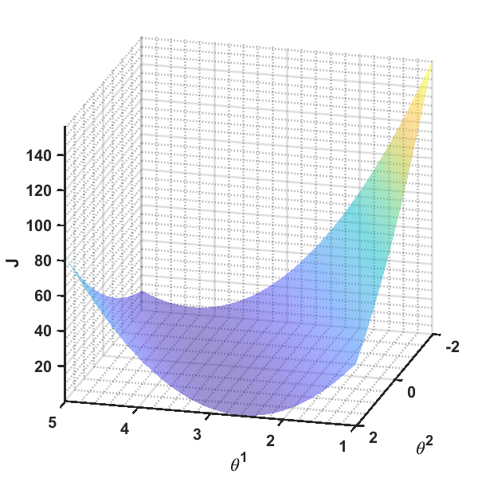
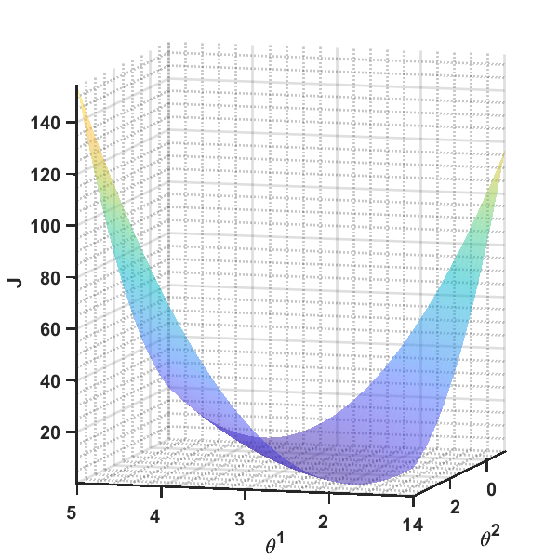
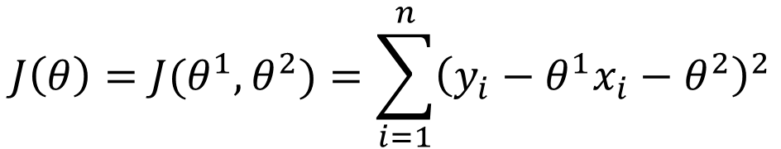
Example: Line Fitting using Gradient Descent (Continue)
Cost function:
$$J\left(θ\right)=J(θ^{1},θ^{2})=\sum_{i=1}^{n}{{\left(y_{i}−θ^{1}x_{i}−θ^{2}\right)}^{2}}$$

Slide 17
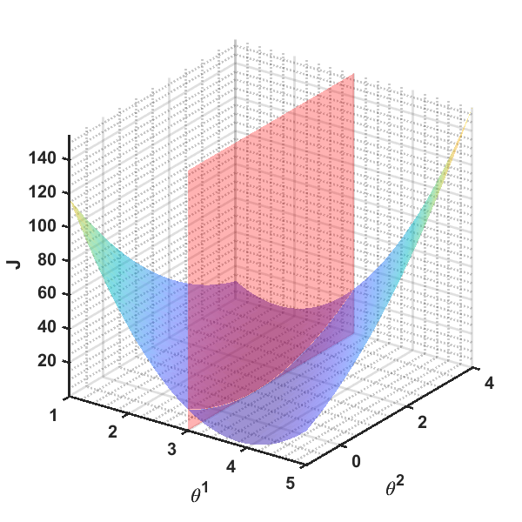
Example: Line Fitting using Gradient Descent (Continue)

Slide 18
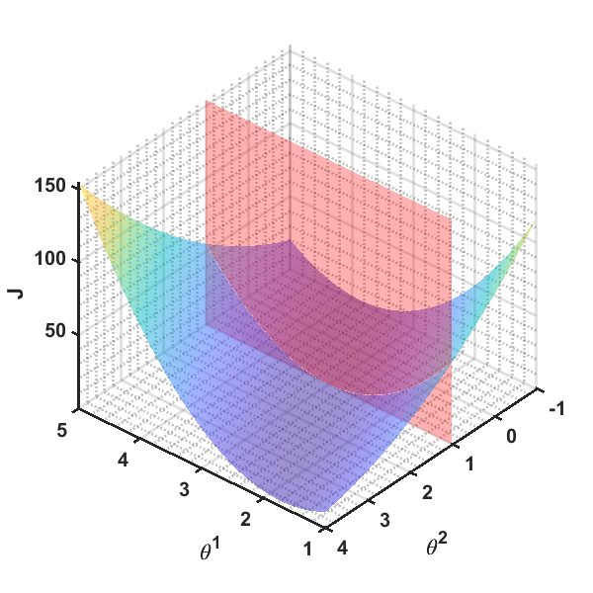
Example: Line Fitting using Gradient Descent (Continue)

Slide 19
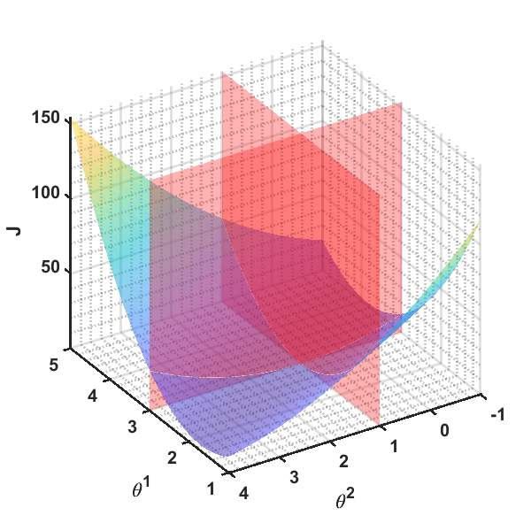
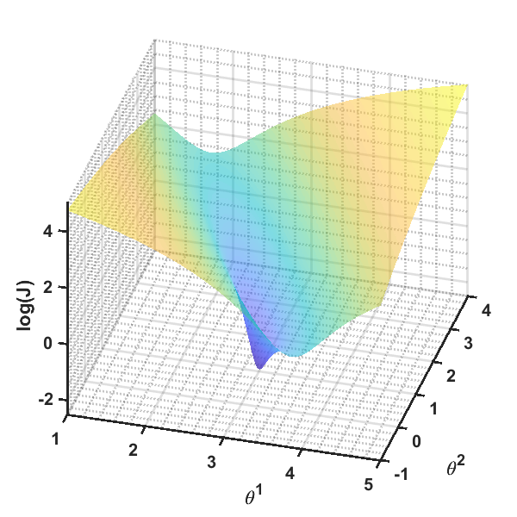

Slide 20
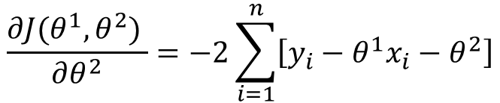
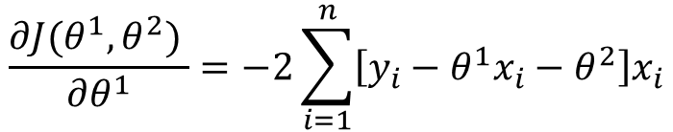
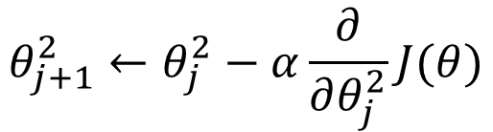
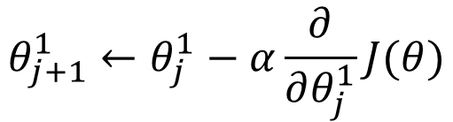
Example: Line Fitting using Gradient Descent (Continue)
$$\frac{∂J(θ^{1},θ^{2}) }{∂θ^{1}}=−2\sum_{i=1}^{n}{\left[y_{i}−θ^{1}x_{i}−θ^{2}\right]x_{i}}$$
$$θ_{j+1}^{1}←θ_{j}^{1}−α\frac{∂}{∂θ_{j}^{1}}J(θ)$$
$$\frac{∂J(θ^{1},θ^{2}) }{∂θ^{2}}=−2\sum_{i=1}^{n}{\left[y_{i}−θ^{1}x_{i}−θ^{2}\right]}$$
$$θ_{j+1}^{2}←θ_{j}^{2}−α\frac{∂}{∂θ_{j}^{2}}J(θ)$$
1 2 3 4 5 6 7 8 | in_data = [1 2 3]; out_data = [4.2 6.8 10.1]; itr = 12; l_r = 0.08; t1 = zeros(itr,1); t1(1) = 1; t2 = zeros(itr,1); t2(1) = 0;
9 10 11 12 13 14 15 16 | J1 = @(th1, t2) -2*sum((out_data-t1*in_data-t2).*in_data); J2 = @(th1, t2) -2*sum((out_data-t1*in_data-t2)); for ii=1:n_iter-1 t1(ii+1) = t1(ii) - l_r*J1(t1(ii), t2(ii)); t2(ii+1) = t2(ii) - l_r*J2(t1(ii), t2(ii)); end

Slide 21
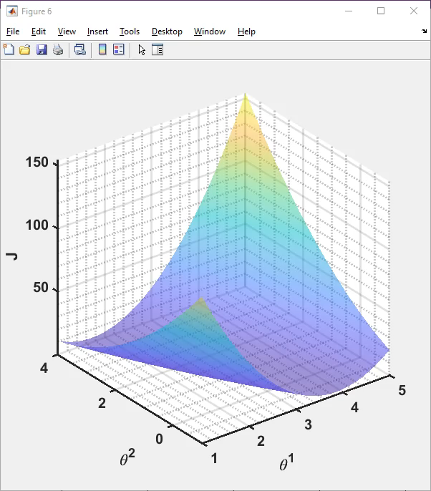

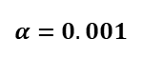
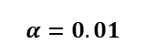
Iter. | 1 | 2 | 3 | 4 | 5 | 6 | 7 | 8 | 9 | 10 | 11 | 12
$$θ^{1}$$ | 1 | 1.682 | 2.1368 | 2.440011 | 2.642082 | 2.776673 | 2.866242 | 2.925774 | 2.965265 | 2.991388 | 3.008593 | 3.019848
$$θ^{1}$$ | 0 | 0.302 | 0.50404 | 0.639382 | 0.730217 | 0.791354 | 0.832672 | 0.860763 | 0.880024 | 0.893391 | 0.902821 | 0.909621
$$α=0.01$$
Iter. | 1 | 2 | 3 | 4 | 5 | 6 | 7 | 8 | 9 | 10 | 11 | 12
$$θ^{1}$$ | 1 | 1.0682 | 1.134128 | 1.19786 | 1.259468 | 1.319024 | 1.376595 | 1.432248 | 1.486047 | 1.538053 | 1.588325 | 1.636923
$$θ^{1}$$ | 0 | 0.0302 | 0.0594 | 0.087634 | 0.114934 | 0.141331 | 0.166855 | 0.191535 | 0.215398 | 0.238473 | 0.260786 | 0.282361
$$α=0.001$$

Slide 22
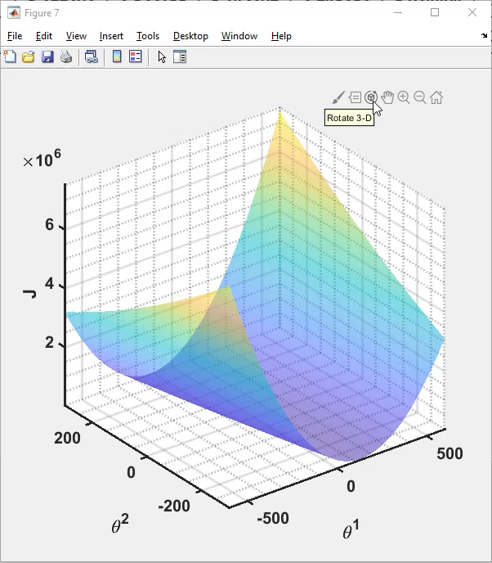

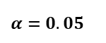
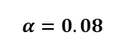
Iter. | 1 | 2 | 3 | 4 | 5 | 6 | 7 | 8 | 9 | 10 | 11 | 12
$$θ^{1}$$ | 1 | 6.456 | -2.6288 | 12.45853 | -12.6348 | 29.06521 | -40.2649 | 74.97162 | -116.597 | 201.8388 | -327.509 | 552.42
$$θ^{1}$$ | 0 | 2.416 | -1.56544 | 5.085619 | -5.93967 | 12.41676 | -18.0699 | 32.63401 | -51.6271 | 88.46348 | -144.388 | 242.7028
$$α=0.08$$
Iter. | 1 | 2 | 3 | 4 | 5 | 6 | 7 | 8 | 9 | 10 | 11 | 12
$$θ^{1}$$ | 1 | 4.41 | 2.14 | 3.6414 | 2.63902 | 3.299202 | 2.855733 | 3.145209 | 2.948232 | 3.074404 | 2.98619 | 3.040475
$$θ^{1}$$ | 0 | 1.51 | 0.521 | 1.1907 | 0.75865 | 1.057643 | 0.870829 | 1.00614 | 0.927173 | 0.990081 | 0.958415 | 0.989177
$$α=0.05$$

Slide 23
Stochastic Gradient Descent
https://www.quora.com/What-is-an-intuitive-explanation-of-stochastic-gradient-descent

Slide 24
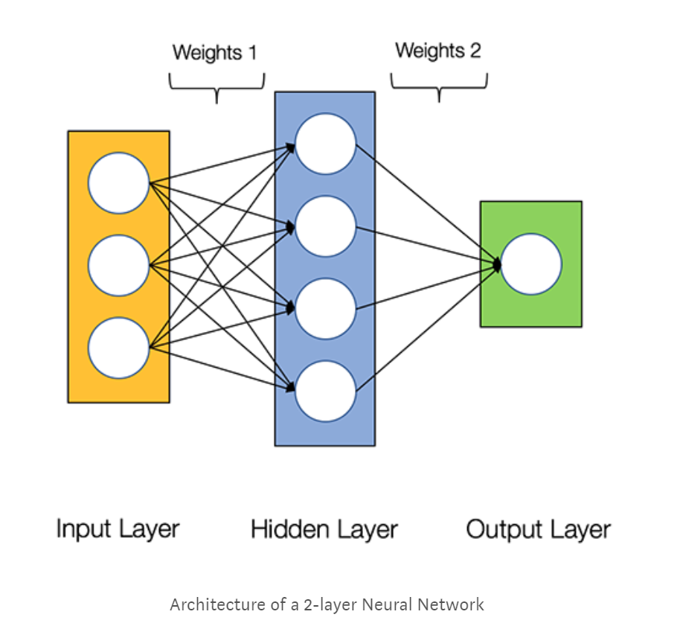
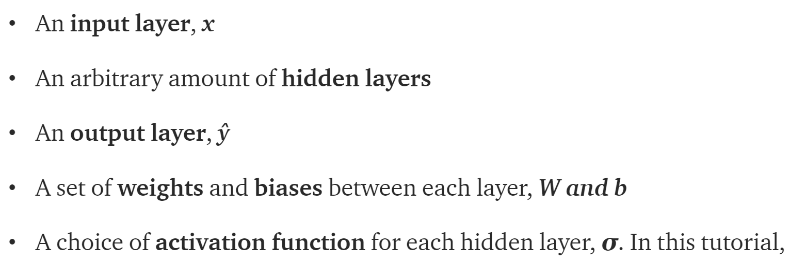
What’s a Neural Network

Slide 25
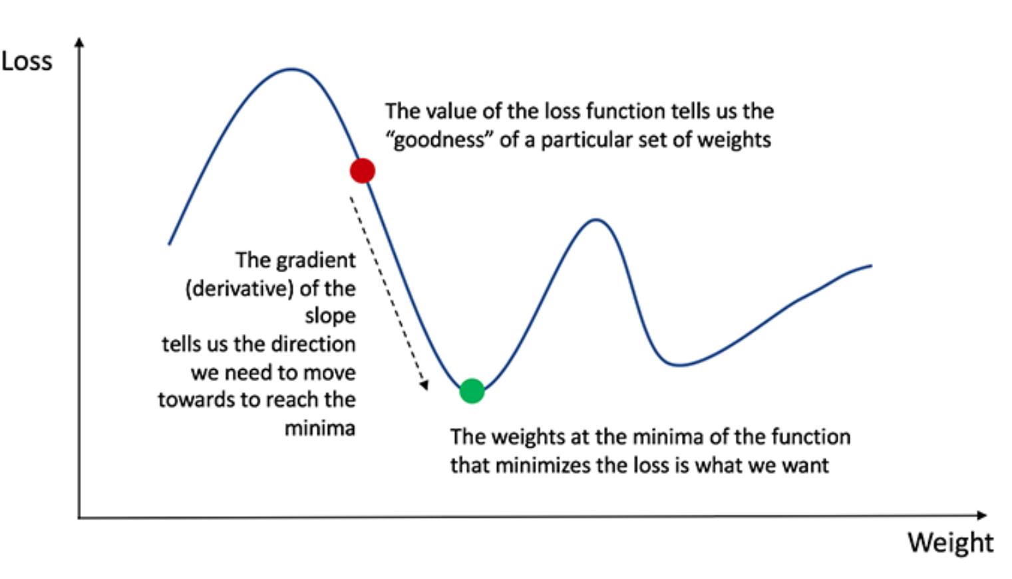
Training the Neural Network
Naturally, the right values for the weights and biases determines the strength of the predictions. The process of fine-tuning the weights and biases from the input data is known as training the Neural Network.
Our goal in training is to find the best set of weights and biases that minimizes the loss function.
Calculating the predicted output y, known as feedforward
Updating the weights and biases, known as backpropagation

Slide 26
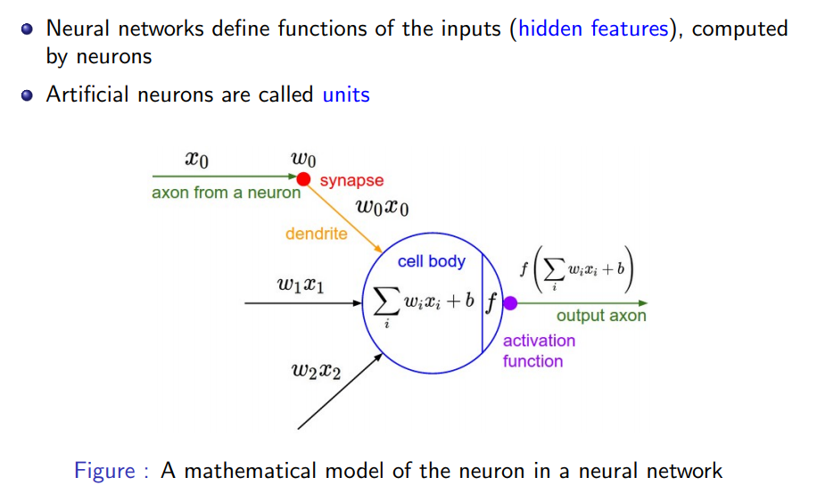
Mathematical Model of a Neuron

Slide 27
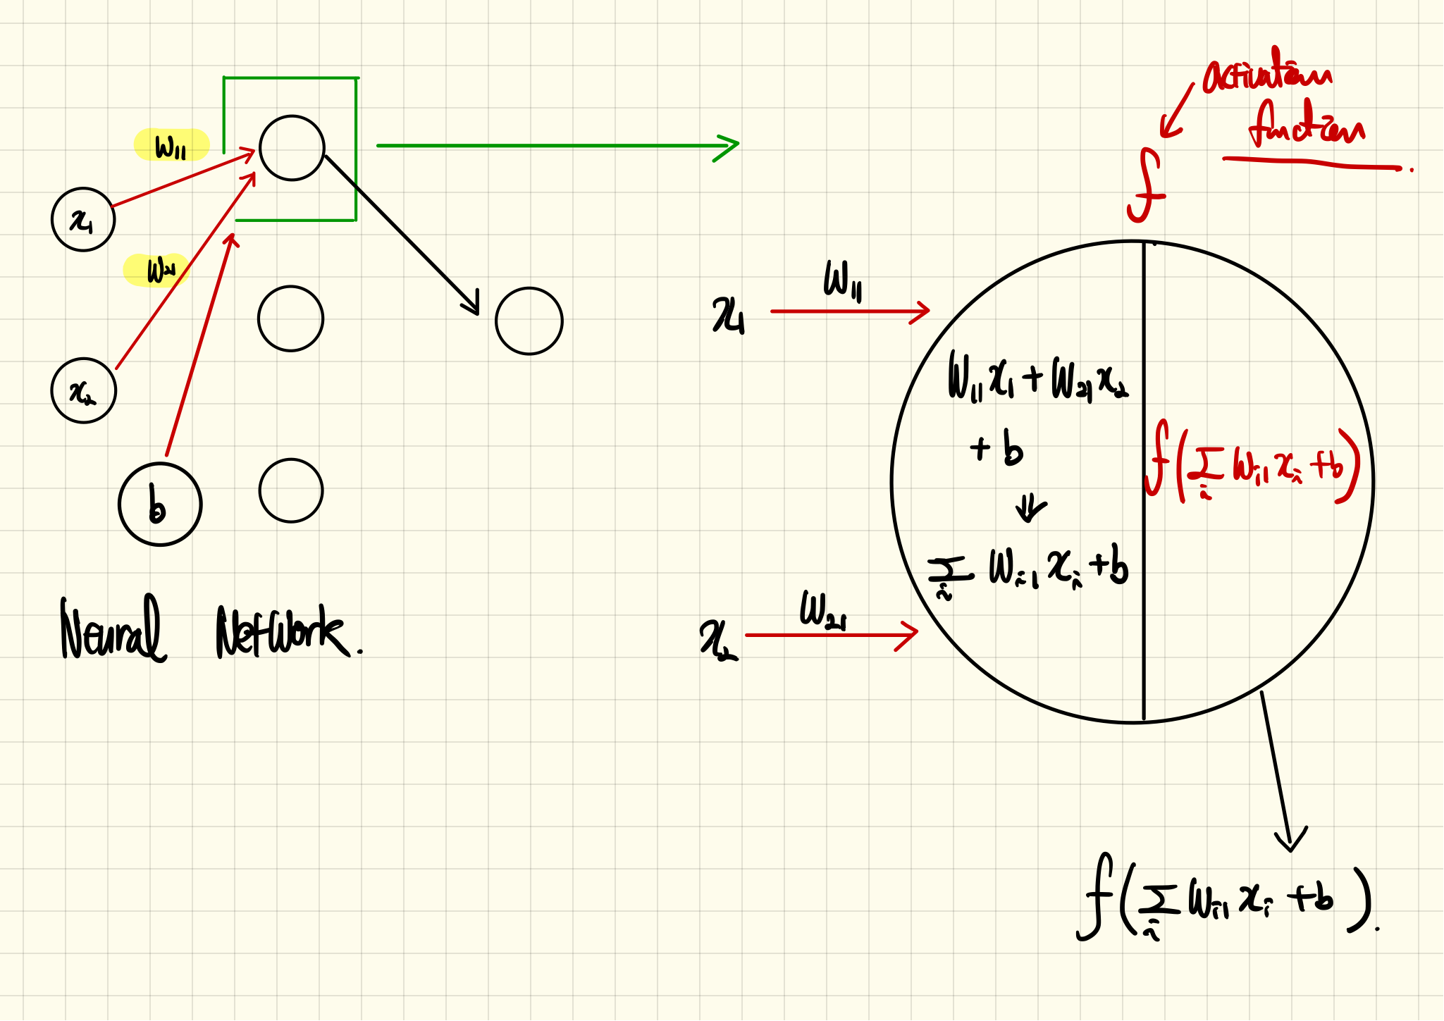
Mathematical Model of a Neuron (Continue)

Slide 28
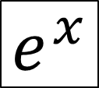
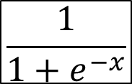
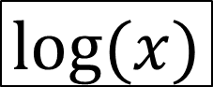
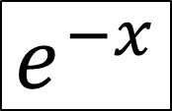
Some Functions
$$e^{x}$$
$$e^{−x}$$
$$\frac{1}{1+e^{−x}}$$
$$log⁡(x)$$

Slide 29
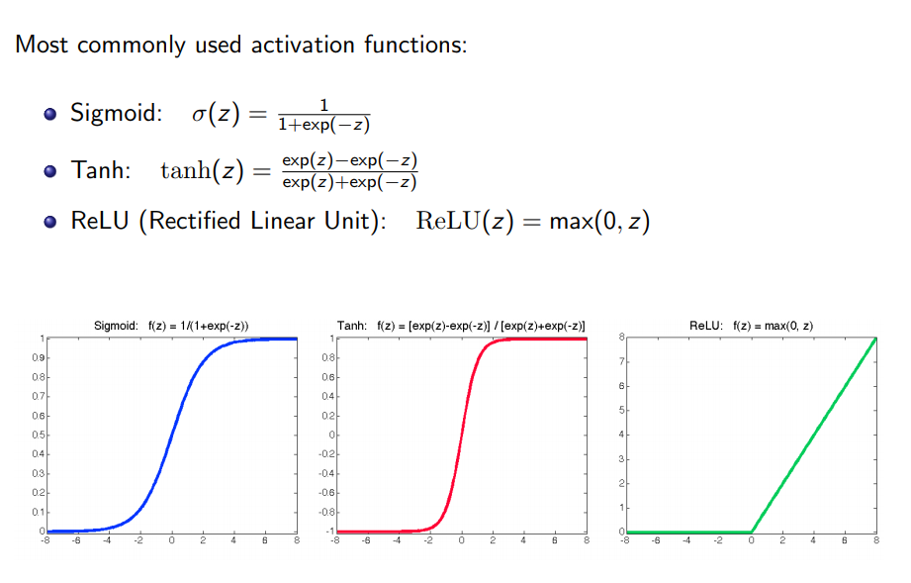
Activation Functions

Slide 30

Activation Functions and Their Derivatives
https://towardsdatascience.com/activation-functions-neural-networks-1cbd9f8d91d6

Slide 31
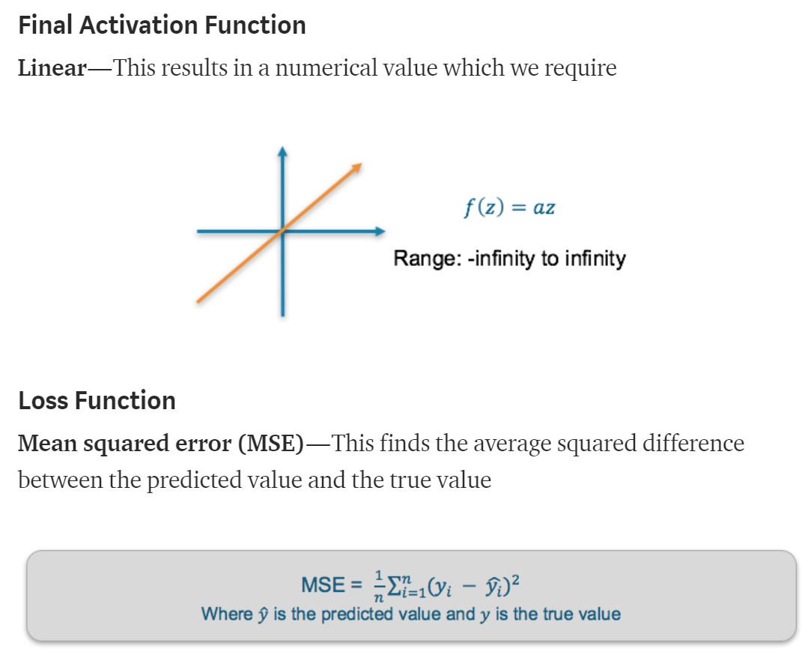
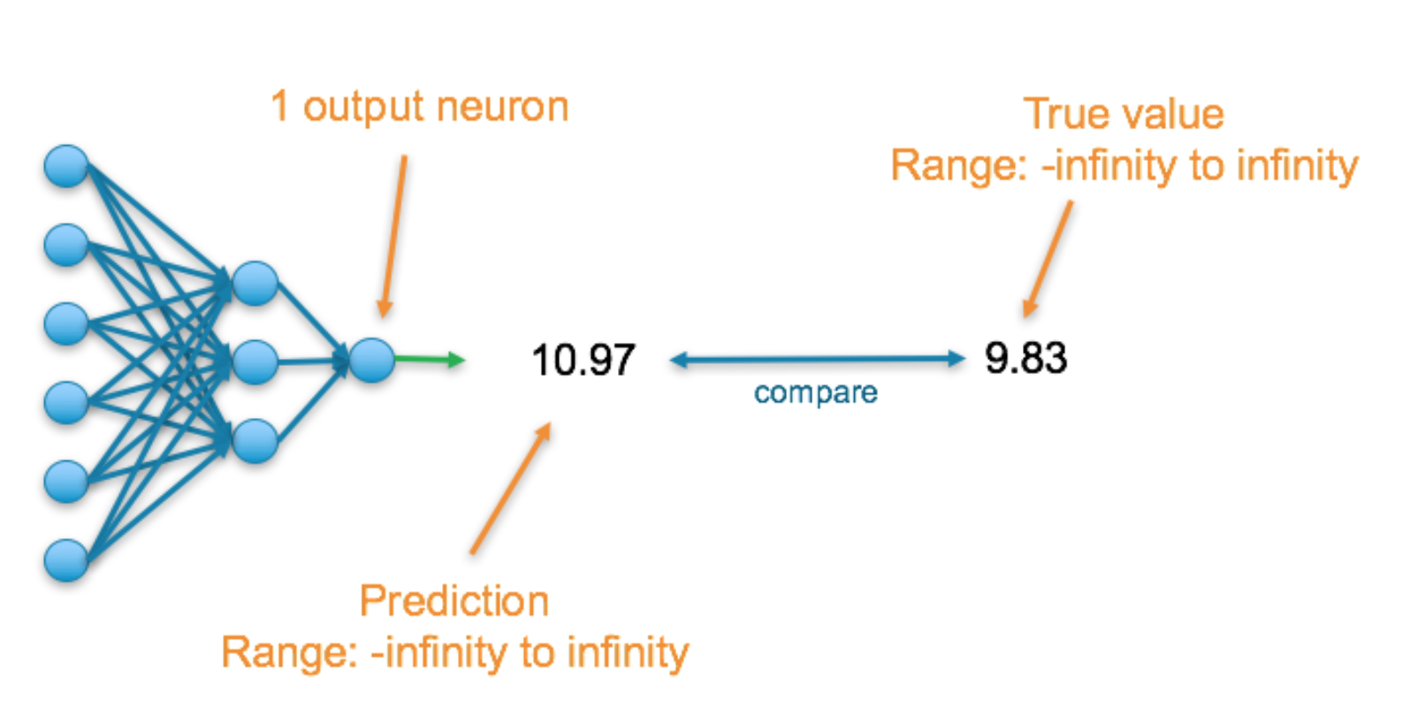
Loss Function
There are many available loss functions, and the nature of our problem should dictate our choice of loss function.
Regression

Slide 32


Loss Function (Continue)

Slide 33


Loss Function (Continue)

Slide 34

Softmax Function

Slide 35

A Step-by-step Forward and Backward Propagation
One hidden layer (two hidden neurons)
Two output neuron
Two input neuron
Activation function: Logistic function
Two input → Two output

Slide 36

Initial Weights, Biases, and Training Inputs/Outputs

Slide 37





Forward Pass
Logistic function

Slide 38



Forward Pass (Continue)

Slide 39




Calculating the Total Error
End of a forward pass

Slide 40
Backward Pass
Our goal with backpropagation is to update each of the weights in the network so that they cause the actual output to be closer the target output, thereby minimizing the error for each output neuron and the network as a whole. Our goal is to make the values in the red boxes 0.01 and 0.99, respectively by changing (updating) the weights.
0.3775
0.593
1.106
0.751
0.393
0.596
1.224
0.773

Slide 41


Output Layer
Chain rule

Slide 42




Output Layer (Continue)

Slide 43

Output Layer (Continue)

Slide 44


Output Layer (Continue)

Slide 45



Output Layer (Continue)

Slide 46

Hidden Layer
W1, W2, W3, and W4 contribute both the E_{o1} and E_{o2}

Slide 47
What Did We Compute?
o2
o2
7
o2
o2
7
o2

Slide 48




Hidden Layer (Continue)
=

Slide 49



Hidden Layer (Continue)
=

Slide 50


Hidden Layer (Continue)

Slide 51

Hidden Layer (Continue)

Slide 52


Complete One Iteration (Forward and Back Propagation)

Slide 53


Another Example: A Step-by-step Forward and Backward Propagation
Two hidden layer
Three hidden neuron in each layer
Three output neuron
Three input neuron
Different activation functions
Three input → Three output
https://medium.com/@14prakash/back-propagation-is-very-simple-who-made-it-complicated-97b794c97e5c

Slide 54



Derivatives of Activation Functions

Slide 55

Initializing Network

Slide 56


Forward Propagation: Layer-1

Slide 57


Forward Propagation: Layer-2

Slide 58


Forward Propagation: Layer-3

Slide 59


Cross Entropy
https://stackoverflow.com/questions/36515202/why-is-the-cross-entropy-method-preferred-over-mean-squared-error-in-what-cases

Slide 60


Back Propagation: Layer-2 − Output

Slide 61

Back Propagation: Layer-2 − Output (Continue)

Slide 62

Back Propagation: Layer-2 − Output (Continue)

Slide 63

Back Propagation: Layer-2 − Output (Continue)

Slide 64


Back Propagation: Layer-2 − Output (Continue)

Slide 65


Back Propagation: Layer-1 − Layer 2

Slide 66


Back Propagation: Layer-1 − Layer 2 (Continue)

Slide 67


Back Propagation: Layer-1 − Layer 2 (Continue)

Slide 68


Back Propagation: Layer-1 − Layer 2 (Continue)

Slide 69




Gradient Descent Variants
Batch gradient descent: Batch Gradient Descent is when we sum up over all examples on each iteration when performing the updates to the parameters. Therefore, for each update, we have to sum over all examples:
Mini-batch gradient descent: Instead of going over all examples, Mini-batch Gradient Descent sums up over lower number of examples based on the batch size. Therefore, learning happens on each mini-batch of b examples:
Stochastic gradient descent: Instead of going through all examples, Stochastic Gradient Descent (SGD) performs the parameters update on each example (x^{i},y^{i}). Therefore, learning happens on every example:
https://towardsdatascience.com/gradient-descent-algorithm-and-its-variants-10f652806a3
https://medium.com/@montjoile/an-introduction-to-gradient-descent-algorithm-34cf3cee752b

Slide 70



Epoch vs Batch Size vs Iterations
https://towardsdatascience.com/epoch-vs-iterations-vs-batch-size-4dfb9c7ce9c9

Slide 71

https://ml-cheatsheet.readthedocs.io/en/latest/gradient_descent.html
$$\text{https}\text{://}\text{mccormickml}\text{.}\text{com}\text{/2014/03/04/}\text{gradient}\text{−}\text{descent}\text{−}\text{derivation}\text{/}$$

